Slide 1
Cutnell/Johnson Physics 7th edition
Classroom Response System Questions
Chapter 9 Rotational Dynamics
Interactive Lecture Questions

Slide 2
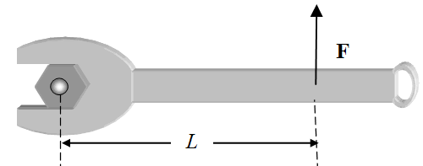
9.1.1. You are using a wrench in an attempt to
loosen a nut by applying a force as shown. But
this fails to loosen the nut. Which of the following
choices is most likely to loosen this tough nut?
a) Tie a rope of length 2L to the wrench at the same location and apply the same force as shown.
b) Place a pipe of length 2L over the handle of the wrench and apply the same force to the opposite end (farthest from the nut).
c) Double the force to 2.
d) Doubling the length or doubling the force will have the same result, but doubling the length is easier.
e) Continue applying the same force as in the drawing and eventually the nut will loosen.

Slide 3
9.1.1. You are using a wrench in an attempt to
loosen a nut by applying a force as shown. But
this fails to loosen the nut. Which of the following
choices is most likely to loosen this tough nut?
a) Tie a rope of length 2L to the wrench at the same location and apply the same force as shown.
b) Place a pipe of length 2L over the handle of the wrench and apply the same force to the opposite end (farthest from the nut).
c) Double the force to 2.
d) Doubling the length or doubling the force will have the same result, but doubling the length is easier.
e) Continue applying the same force as in the drawing and eventually the nut will loosen.

Slide 4
9.1.2. A 1.5-kg ball is tied to the end of a string. The ball is then swung at a constant angular velocity of 4π rad/s in a horizontal circle of radius 2.0 m. What is the torque on the stone?
a) 18 Nm
b) 29 Nm
c) 36 Nm
d) 59 Nm
e) zero Nm

Slide 5
9.1.2. A 1.5-kg ball is tied to the end of a string. The ball is then swung at a constant angular velocity of 4π rad/s in a horizontal circle of radius 2.0 m. What is the torque on the stone?
a) 18 Nm
b) 29 Nm
c) 36 Nm
d) 59 Nm
e) zero Nm

Slide 6
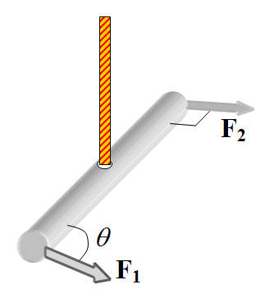
9.1.3. A 1.0-m long steel bar is suspended from a rope from the ceiling as shown. The rope is attached to the bar at its mid-point. A force directed at an angle θ is applied at one end. At the other end, a force is applied perpendicular to the bar. If the magnitudes of the two forces are equal, for which one of the following values of the angle θ will the net torque on the bar have the smallest magnitude? The net torque is the sum of the torques on the bar.
a) 0°
b) 90°
c) 135°
d) 180°
e) 270°

Slide 7
9.1.3. A 1.0-m long steel bar is suspended from a rope from the ceiling as shown. The rope is attached to the bar at its mid-point. A force directed at an angle θ is applied at one end. At the other end, a force is applied perpendicular to the bar. If the magnitudes of the two forces are equal, for which one of the following values of the angle θ will the net torque on the bar have the smallest magnitude? The net torque is the sum of the torques on the bar.
a) 0°
b) 90°
c) 135°
d) 180°
e) 270°

Slide 8
9.1.4. An interesting method for exercising a dog is to have it walk on the rough surface a circular platform that freely rotates about its center as shown. When the dog begins walking near the outer edge of the platform as shown, how will the platform move, if at all? Assume the bearing on which the platform can rotate is frictionless.
a) When the dog walks, the platform will rotate counterclockwise when viewed from above.
b) When the dog walks, the platform will rotate clockwise when viewed from above.
c) When the dog walks, the platform will not rotate.

Slide 9
9.1.4. An interesting method for exercising a dog is to have it walk on the rough surface a circular platform that freely rotates about its center as shown. When the dog begins walking near the outer edge of the platform as shown, how will the platform move, if at all? Assume the bearing on which the platform can rotate is frictionless.
a) When the dog walks, the platform will rotate counterclockwise when viewed from above.
b) When the dog walks, the platform will rotate clockwise when viewed from above.
c) When the dog walks, the platform will not rotate.

Slide 10
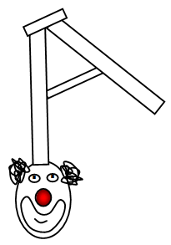
9.2.1. At the circus, a clown balances a step ladder on his forehead.
A few people in the audience notice that he is continually moving to
keep the ladder from falling off his forehead. Why is this movement
necessary?
a) The clown is trying to apply a torque to the ladder in the direction opposite to other torques on the ladder.
b) The clown is trying to keep the center of mass of the ladder directly above his head so that the torque due to the gravitational force is zero Nm.
c) By rocking the ladder on his forehead, the ladder will be more stable than if it were stationary. This is similar to riding a bicycle. You can easily balance a bicycle when it’s
rolling, but not when it’s stationary.
d) This movement is not necessary. The clown is trying to make this look harder than it really is for entertainment value. The ladder will easily balance in the clown’s forehead.

Slide 11
9.2.1. At the circus, a clown balances a step ladder on his forehead.
A few people in the audience notice that he is continually moving to
keep the ladder from falling off his forehead. Why is this movement
necessary?
a) The clown is trying to apply a torque to the ladder in the direction opposite to other torques on the ladder.
b) The clown is trying to keep the center of mass of the ladder directly above his head so that the torque due to the gravitational force is zero Nm.
c) By rocking the ladder on his forehead, the ladder will be more stable than if it were stationary. This is similar to riding a bicycle. You can easily balance a bicycle when it’s
rolling, but not when it’s stationary.
d) This movement is not necessary. The clown is trying to make this look harder than it really is for entertainment value. The ladder will easily balance in the clown’s forehead.

Slide 12
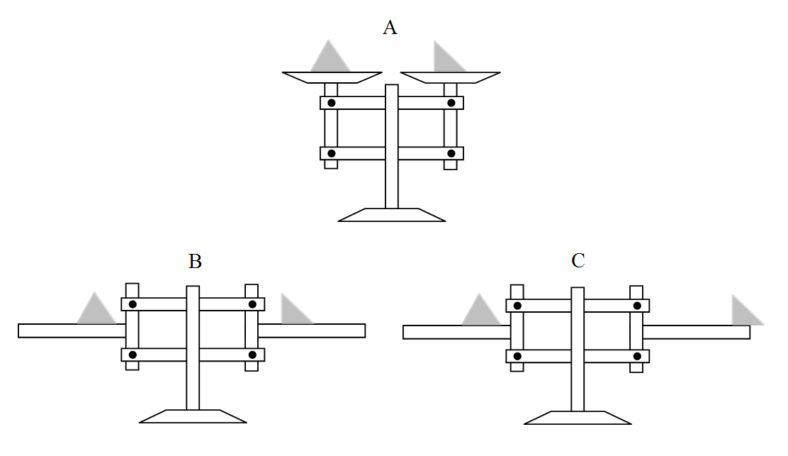
9.2.2. In the seventeenth century, French mathematician Gilles de Roberval developed a balance, shown in part A in the figure, for commercial weighing and it is still in use today. A variation of this device, shown part B of the figure, is used for physics demonstrations. In this case, the two triangular objects have equal mass and rest on the two horizontal arms at an equal distance from the vertical bars. When the system is released, there is no movement because the system is in equilibrium. One of the objects is then slid to the right as shown in part C, what will happen when the system is released?
a) The arm on the right
will go up.
b) The arm on the left
will go up.
c) Neither arm will move.

Slide 13
9.2.2. In the seventeenth century, French mathematician Gilles de Roberval developed a balance, shown in part A in the figure, for commercial weighing and it is still in use today. A variation of this device, shown part B of the figure, is used for physics demonstrations. In this case, the two triangular objects have equal mass and rest on the two horizontal arms at an equal distance from the vertical bars. When the system is released, there is no movement because the system is in equilibrium. One of the objects is then slid to the right as shown in part C, what will happen when the system is released?
a) The arm on the right
will go up.
b) The arm on the left
will go up.
c) Neither arm will move.

Slide 14
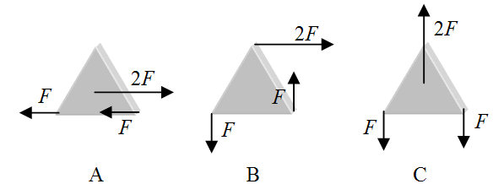
9.2.3. Consider the three situations shown in the figure. Three forces act on the triangular object in different ways. Two of the forces have magnitude F and one of the forces has a magnitude 2F. In which case(s), if any, will the object be in equilibrium? In each case, the forces may act at the center of gravity or at the center of a corner.
a) A only
b) B only
c) C only
d) A and C
e) A and B

Slide 15
9.2.3. Consider the three situations shown in the figure. Three forces act on the triangular object in different ways. Two of the forces have magnitude F and one of the forces has a magnitude 2F. In which case(s), if any, will the object be in equilibrium? In each case, the forces may act at the center of gravity or at the center of a corner.
a) A only
b) B only
c) C only
d) A and C
e) A and B

Slide 16
9.2.4. A 4.0-m board is resting directly on top of a 4.0-m long table. The weight of the board is 340 N. An object with a weight of 170 N is placed at the right end of the board. What is the maximum horizontal distance that the board can be moved toward the right such that the board remains in equilibrium?
a) 0.75 m
b) 1.0 m
c) 1.3 m
d) 1.5 m
e) 2.0 m

Slide 17
9.2.4. A 4.0-m board is resting directly on top of a 4.0-m long table. The weight of the board is 340 N. An object with a weight of 170 N is placed at the right end of the board. What is the maximum horizontal distance that the board can be moved toward the right such that the board remains in equilibrium?
a) 0.75 m
b) 1.0 m
c) 1.3 m
d) 1.5 m
e) 2.0 m

Slide 18
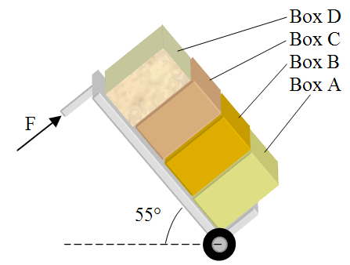
9.2.5. Jack is moving to a new apartment. He is loading a hand truck with four boxes: box A is full of books and weighs 133 N, box B has more books and weighs 111 N, box C contains his music collection on CDs and weighs 65 N, and box D contains clothes and weighs 47 N. The height of each box is 0.30 m. The center of gravity of each of the boxes is located at its center. In preparing to pull the hand truck up the ramp of the moving truck he rotates it to the position shown. What is the magnitude of the force that Jack is applying to the hand truck at a distance of 1.4 m from the axel of the wheel?
a) 360 N
b) 200 N
c) 150 N
d) 96 N
e) 69 N

Slide 19
9.2.5. Jack is moving to a new apartment. He is loading a hand truck with four boxes: box A is full of books and weighs 133 N, box B has more books and weighs 111 N, box C contains his music collection on CDs and weighs 65 N, and box D contains clothes and weighs 47 N. The height of each box is 0.30 m. The center of gravity of each of the boxes is located at its center. In preparing to pull the hand truck up the ramp of the moving truck he rotates it to the position shown. What is the magnitude of the force that Jack is applying to the hand truck at a distance of 1.4 m from the axel of the wheel?
a) 360 N
b) 200 N
c) 150 N
d) 96 N
e) 69 N

Slide 20
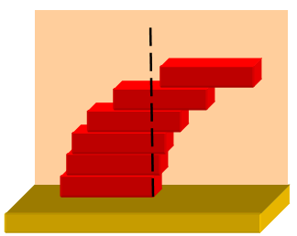
9.3.1. Six identical bricks are stacked on top of one another. Note
that the vertical dashed line indicates that the left edge of the top
brick is located to the right of the right side of the bottom brick.
Is the equilibrium configuration shown possible, why or why not?
a) Yes, this is possible as long as the combined center of gravity of the blocks above a given brick does not extend beyond the right side of the brick below.
b) Yes, this is possible as long as the left side of each block is directly above the center of gravity of the brick directly below it.
c) Yes, this is possible as long as the center of gravity of the blocks above a given brick remains directly above the center of gravity of the blocks below that brick.
d) No, this is not possible because the center of gravity of the top two blocks extends beyond the right edge of the bottom two blocks.
e) No, because the center of gravity of the top block is to the right of the third block from the top.

Slide 21
9.3.1. Six identical bricks are stacked on top of one another. Note
that the vertical dashed line indicates that the left edge of the top
brick is located to the right of the right side of the bottom brick.
Is the equilibrium configuration shown possible, why or why not?
a) Yes, this is possible as long as the combined center of gravity of the blocks above a given brick does not extend beyond the right side of the brick below.
b) Yes, this is possible as long as the left side of each block is directly above the center of gravity of the brick directly below it.
c) Yes, this is possible as long as the center of gravity of the blocks above a given brick remains directly above the center of gravity of the blocks below that brick.
d) No, this is not possible because the center of gravity of the top two blocks extends beyond the right edge of the bottom two blocks.
e) No, because the center of gravity of the top block is to the right of the third block from the top.

Slide 22
9.3.2. Consider the diamond-shaped object shown that is designed to balance on a thin thread like a tight rope walker at a circus. At the bottom of the diamond, there is a narrow notch that is as wide as the thickness of the thread. The mass of each of the metal spheres at the ends of the wires connected to the diamond is equal to the mass of the diamond. Which one of the points indicated is the most likely location of the center of gravity for this object?
a) A
b) B
c) C
d) D
e) E

Slide 23
9.3.2. Consider the diamond-shaped object shown that is designed to balance on a thin thread like a tight rope walker at a circus. At the bottom of the diamond, there is a narrow notch that is as wide as the thickness of the thread. The mass of each of the metal spheres at the ends of the wires connected to the diamond is equal to the mass of the diamond. Which one of the points indicated is the most likely location of the center of gravity for this object?
a) A
b) B
c) C
d) D
e) E

Slide 24
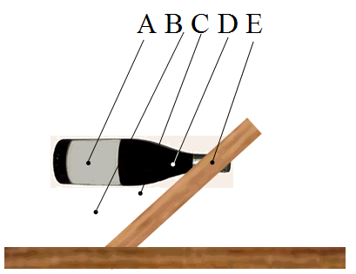
9.3.3. Consider the object shown. A bottle is inserted into a board that has a hole in it. The bottle and board are then set up on the table and are in equilibrium. Which of the points indicated is the most likely location for the center of mass for the bottle and board system?
a) A
b) B
c) C
d) D
e) E

Slide 25
9.3.3. Consider the object shown. A bottle is inserted into a board that has a hole in it. The bottle and board are then set up on the table and are in equilibrium. Which of the points indicated is the most likely location for the center of mass for the bottle and board system?
a) A
b) B
c) C
d) D
e) E

Slide 26
9.4.1. Two solid disks, which are free to rotate independently about the same axis that passes through their centers and perpendicular to their faces, are initially at rest. The two disks have the same mass, but one of has a radius R and the other has a radius 2R. A force of magnitude F is applied to the edge of the larger radius disk and it begins rotating. What force must be applied to the edge of the smaller disk so that the angular acceleration is the same as that for the larger disk? Express your answer in terms of the force F applied to the larger disk.
a) 0.25F
b) 0.50F
c) F
d) 1.5F
e) 2F

Slide 27
9.4.1. Two solid disks, which are free to rotate independently about the same axis that passes through their centers and perpendicular to their faces, are initially at rest. The two disks have the same mass, but one of has a radius R and the other has a radius 2R. A force of magnitude F is applied to the edge of the larger radius disk and it begins rotating. What force must be applied to the edge of the smaller disk so that the angular acceleration is the same as that for the larger disk? Express your answer in terms of the force F applied to the larger disk.
a) 0.25F
b) 0.50F
c) F
d) 1.5F
e) 2F

Slide 28
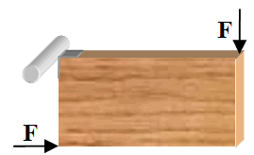
9.4.2. The corner of a rectangular piece of wood is attached to a rod that is free to rotate as shown. The length of the longer side of the rectangle is 4.0 m, which is twice the length of the shorter side. Two equal forces are applied to two of the corners with magnitudes of 22 N. What is the magnitude of the net torque and direction of rotation on the block, if any?
a) 44 Nm, clockwise
b) 44 Nm, counterclockwise
c) 88 Nm, clockwise
d) 88 Nm, counterclockwise
e) zero Nm, no rotation

Slide 29
9.4.2. The corner of a rectangular piece of wood is attached to a rod that is free to rotate as shown. The length of the longer side of the rectangle is 4.0 m, which is twice the length of the shorter side. Two equal forces are applied to two of the corners with magnitudes of 22 N. What is the magnitude of the net torque and direction of rotation on the block, if any?
a) 44 Nm, clockwise
b) 44 Nm, counterclockwise
c) 88 Nm, clockwise
d) 88 Nm, counterclockwise
e) zero Nm, no rotation

Slide 30
9.5.1. Four objects start from rest and roll without slipping down a ramp. The objects are a solid sphere, a hollow cylinder, a solid cylinder, and a hollow sphere. Each of the objects has the same radius and the same mass, but they are made from different materials. Which object will have the greatest speed at the bottom of the ramp?
a) Since they are all starting from rest, all of the objects will have the same speed at the bottom as a result of the conservation of mechanical energy.
b) solid sphere
c) hollow cylinder
d) solid cylinder
e) hollow sphere

Slide 31
9.5.1. Four objects start from rest and roll without slipping down a ramp. The objects are a solid sphere, a hollow cylinder, a solid cylinder, and a hollow sphere. Each of the objects has the same radius and the same mass, but they are made from different materials. Which object will have the greatest speed at the bottom of the ramp?
a) Since they are all starting from rest, all of the objects will have the same speed at the bottom as a result of the conservation of mechanical energy.
b) solid sphere
c) hollow cylinder
d) solid cylinder
e) hollow sphere

Slide 32
9.5.2. A bowling ball is rolling without slipping at constant speed toward the pins on a lane. What percentage of the ball’s total kinetic energy is translational kinetic energy?
a) 50 %
b) 71 %
c) 46 %
d) 29 %
e) 33 %

Slide 33
9.5.2. A bowling ball is rolling without slipping at constant speed toward the pins on a lane. What percentage of the ball’s total kinetic energy is translational kinetic energy?
a) 50 %
b) 71 %
c) 46 %
d) 29 %
e) 33 %

Slide 34
9.5.3. A hollow cylinder is rotating about an axis that passes through the center of both ends. The radius of the cylinder is r. At what angular speed ω must the this cylinder rotate to have the same total kinetic energy that it would have if it were moving horizontally with a speed v without rotation?
a)
b)
c)
d)
e)

Slide 35
9.5.3. A hollow cylinder is rotating about an axis that passes through the center of both ends. The radius of the cylinder is r. At what angular speed ω must the this cylinder rotate to have the same total kinetic energy that it would have if it were moving horizontally with a speed v without rotation?
a)
b)
c)
d)
e)

Slide 36
9.5.4. Two solid cylinders are rotating about an axis that passes through the center of both ends of each cylinder. Cylinder A has three times the mass and twice the radius of cylinder B, but they have the same rotational kinetic energy. What is the ratio of the angular velocities, ω_{A}/ω_{B}, for these two cylinders?
a) 0.25
b) 0.50
c) 1.0
d) 2.0
e) 4.0

Slide 37
9.5.4. Two solid cylinders are rotating about an axis that passes through the center of both ends of each cylinder. Cylinder A has three times the mass and twice the radius of cylinder B, but they have the same rotational kinetic energy. What is the ratio of the angular velocities, ω_{A}/ω_{B}, for these two cylinders?
a) 0.25
b) 0.50
c) 1.0
d) 2.0
e) 4.0

Slide 38
9.6.1. A star is rotating about an axis that passes through its center. When the star “dies,” the balance between the inward pressure due to the force of gravity and the outward pressure from nuclear processes is no longer present and the star collapses inward and its radius decreases with time. Which one of the following choices best describes what happens as the star collapses?
a) The angular velocity of the star remains constant.
b) The angular momentum of the star remains constant.
c) The angular velocity of the star decreases.
d) The angular momentum of the star decreases.
e) Both angular momentum and angular velocity increase.

Slide 39
9.6.1. A star is rotating about an axis that passes through its center. When the star “dies,” the balance between the inward pressure due to the force of gravity and the outward pressure from nuclear processes is no longer present and the star collapses inward and its radius decreases with time. Which one of the following choices best describes what happens as the star collapses?
a) The angular velocity of the star remains constant.
b) The angular momentum of the star remains constant.
c) The angular velocity of the star decreases.
d) The angular momentum of the star decreases.
e) Both angular momentum and angular velocity increase.

Slide 40
9.6.2. A solid sphere of radius R rotates about an axis that is tangent to the sphere with an angular speed ω. Under the action of internal forces, the radius of the sphere increases to 2R. What is the final angular speed of the sphere?
a) w/4
b) w/2
c) ω
d) 2ω
e) 4ω

Slide 41
9.6.2. A solid sphere of radius R rotates about an axis that is tangent to the sphere with an angular speed ω. Under the action of internal forces, the radius of the sphere increases to 2R. What is the final angular speed of the sphere?
a) w/4
b) w/2
c) ω
d) 2ω
e) 4ω

