Slide 1
Cutnell/Johnson Physics 7th edition
Classroom Response System Questions
Chapter 2 Kinematics in One Dimension
Interactive Lecture Questions

Slide 2
2.1.1. In the morning, a bird is in Tampa, Florida. In the afternoon, the bird is near Orlando, Florida. Given this information, which one of the following statements best describes the relationship between the magnitude of the bird’s displacement and the distance the bird traveled?
a) The distance traveled is either greater than or equal to the magnitude of bird’s displacement.
b) The distance traveled is either less than or equal to the magnitude of bird’s displacement.
c) The distance traveled is equal to the magnitude of bird’s displacement.
d) The distance traveled is either less than or greater than the magnitude of bird’s displacement.
e) The distance traveled is greater than the magnitude of bird’s displacement.

Slide 3
2.1.1. In the morning, a bird is in Tampa, Florida. In the afternoon, the bird is near Orlando, Florida. Given this information, which one of the following statements best describes the relationship between the magnitude of the bird’s displacement and the distance the bird traveled?
a) The distance traveled is either greater than or equal to the magnitude of bird’s displacement.
b) The distance traveled is either less than or equal to the magnitude of bird’s displacement.
c) The distance traveled is equal to the magnitude of bird’s displacement.
d) The distance traveled is either less than or greater than the magnitude of bird’s displacement.
e) The distance traveled is greater than the magnitude of bird’s displacement.

Slide 4
2.1.2. A race car, traveling at constant speed, makes one lap around a circular track of radius r in a time t. The circumference of a circle is given by C = 2πr. Which one of the following statements concerning this car is true?
a) The displacement of the car does not change with time.
b) The instantaneous velocity of the car is constant.
c) The average speed of the car is the same over any time interval.
d) The average velocity of the car is the same over any time interval.
e) The average speed of the car over any time interval is equal to the magnitude of the average velocity over the same time interval.

Slide 5
2.1.2. A race car, traveling at constant speed, makes one lap around a circular track of radius r in a time t. The circumference of a circle is given by C = 2πr. Which one of the following statements concerning this car is true?
a) The displacement of the car does not change with time.
b) The instantaneous velocity of the car is constant.
c) The average speed of the car is the same over any time interval.
d) The average velocity of the car is the same over any time interval.
e) The average speed of the car over any time interval is equal to the magnitude of the average velocity over the same time interval.

Slide 6
2.2.1. A turtle and a rabbit are to have a race. The turtle’s average speed is 0.9 m/s. The rabbit’s average speed is 9 m/s. The distance from the starting line to the finish line is 1500 m. The rabbit decides to let the turtle run before he starts running to give the turtle a head start. What, approximately, is the maximum time the rabbit can wait before starting to run and still win the race?
a) 15 minutes
b) 18 minutes
c) 20 minutes
d) 22 minutes
e) 25 minutes

Slide 7
2.2.1. A turtle and a rabbit are to have a race. The turtle’s average speed is 0.9 m/s. The rabbit’s average speed is 9 m/s. The distance from the starting line to the finish line is 1500 m. The rabbit decides to let the turtle run before he starts running to give the turtle a head start. What, approximately, is the maximum time the rabbit can wait before starting to run and still win the race?
a) 15 minutes
b) 18 minutes
c) 20 minutes
d) 22 minutes
e) 25 minutes

Slide 8
2.2.2. A turtle, moving at a constant velocity of 0.9 m/s due south, is in a race with a rabbit, who runs at a moderate speed of 9 m/s. When the turtle is 45 m from the finish line, the rabbit begins taunting the turtle by running from the turtle to the finish line (without crossing it) and back to the turtle. The rabbit continues going back and forth between the turtle and the finish line until the turtle crosses the finish line. About how many meters does the rabbit travel as the turtle travels that last 45 m? Assume the rabbit always runs at 9 m/s and doesn’t lose any time changing direction.
a) 180 m
b) 270 m
c) 360 m
d) 450 m
e) 540 m

Slide 9
2.2.2. A turtle, moving at a constant velocity of 0.9 m/s due south, is in a race with a rabbit, who runs at a moderate speed of 9 m/s. When the turtle is 45 m from the finish line, the rabbit begins taunting the turtle by running from the turtle to the finish line (without crossing it) and back to the turtle. The rabbit continues going back and forth between the turtle and the finish line until the turtle crosses the finish line. About how many meters does the rabbit travel as the turtle travels that last 45 m? Assume the rabbit always runs at 9 m/s and doesn’t lose any time changing direction.
a) 180 m
b) 270 m
c) 360 m
d) 450 m
e) 540 m

Slide 10
2.3.1. A ball is thrown toward a wall, bounces, and returns to the thrower with the same speed as it had before it bounced. Which one of the following statements correctly describes this situation?
a) The ball was not accelerated during its contact with the wall because its speed remained constant.
b) The instantaneous velocity of the ball from the time it left the thrower’s hand was constant.
c) The only time that the ball had an acceleration was when the ball started from rest and left the hand of the thrower and again when the ball returned to the hand and was stopped.
d) During this situation, the ball was never accelerated.
e) The ball was accelerated during its contact with the wall because its direction changed.

Slide 11
2.3.1. A ball is thrown toward a wall, bounces, and returns to the thrower with the same speed as it had before it bounced. Which one of the following statements correctly describes this situation?
a) The ball was not accelerated during its contact with the wall because its speed remained constant.
b) The instantaneous velocity of the ball from the time it left the thrower’s hand was constant.
c) The only time that the ball had an acceleration was when the ball started from rest and left the hand of the thrower and again when the ball returned to the hand and was stopped.
d) During this situation, the ball was never accelerated.
e) The ball was accelerated during its contact with the wall because its direction changed.

Slide 12
2.3.2. In an air race, two planes are traveling due east. Plane One has a larger acceleration than Plane Two. Both accelerations are in the same direction. Which one of the following statements is true concerning this situation?
a) In the same time interval, the change in the velocity of the Plane Two is greater than that of Plane One.
b) In the same time interval, the change in the velocity of the Plane One is greater than that of Plane Two.
c) Within the time interval, the velocity of the Plane Two remains greater than that of Plane One.
d) Within the time interval, the velocity of the Plane One remains greater than that of Plane Two.
e) Too little information is given to compare the velocities of the planes or how the velocities are changing.

Slide 13
2.3.2. In an air race, two planes are traveling due east. Plane One has a larger acceleration than Plane Two. Both accelerations are in the same direction. Which one of the following statements is true concerning this situation?
a) In the same time interval, the change in the velocity of the Plane Two is greater than that of Plane One.
b) In the same time interval, the change in the velocity of the Plane One is greater than that of Plane Two.
c) Within the time interval, the velocity of the Plane Two remains greater than that of Plane One.
d) Within the time interval, the velocity of the Plane One remains greater than that of Plane Two.
e) Too little information is given to compare the velocities of the planes or how the velocities are changing.

Slide 14
2.3.3. Two cars travel along a level highway. An observer notices that the distance between the cars is increasing. Which one of the following statements concerning this situation is necessarily true?
a) Both cars could be accelerating at the same rate.
b) The leading car has the greater acceleration.
c) The trailing car has the smaller acceleration.
d) The velocity of each car is increasing.
e) At least one of the cars has a non-zero acceleration.

Slide 15
2.3.3. Two cars travel along a level highway. An observer notices that the distance between the cars is increasing. Which one of the following statements concerning this situation is necessarily true?
a) Both cars could be accelerating at the same rate.
b) The leading car has the greater acceleration.
c) The trailing car has the smaller acceleration.
d) The velocity of each car is increasing.
e) At least one of the cars has a non-zero acceleration.

Slide 16
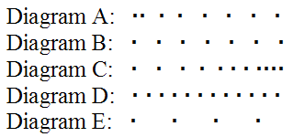
2.3.4. A police cruiser is parked by the side of the road when a speeding car passes. The cruiser follows the speeding car. Consider the following diagrams where the dots represent the cruiser’s position at 0.5-s intervals. Which diagram(s) are possible representations of the cruiser’s motion?
a) A only
b) B, D, or E only
c) C only
d) E only
e) A or C only

Slide 17
2.3.4. A police cruiser is parked by the side of the road when a speeding car passes. The cruiser follows the speeding car. Consider the following diagrams where the dots represent the cruiser’s position at 0.5-s intervals. Which diagram(s) are possible representations of the cruiser’s motion?
a) A only
b) B, D, or E only
c) C only
d) E only
e) A or C only

Slide 18
2.4.1. Starting from rest, two objects accelerate with the same constant acceleration. Object A accelerates for three times as much time as object B, however. Which one of the following statements is true concerning these objects at the end of their respective periods of acceleration?
a) Object A will travel three times as far as object B.
b) Object A will travel nine times as far as object B.
c) Object A will travel eight times as far as object B.
d) Object A will be moving 1.5 times faster than object B.
e) Object A will be moving nine times faster than object B.

Slide 19
2.4.1. Starting from rest, two objects accelerate with the same constant acceleration. Object A accelerates for three times as much time as object B, however. Which one of the following statements is true concerning these objects at the end of their respective periods of acceleration?
a) Object A will travel three times as far as object B.
b) Object A will travel nine times as far as object B.
c) Object A will travel eight times as far as object B.
d) Object A will be moving 1.5 times faster than object B.
e) Object A will be moving nine times faster than object B.

Slide 20
2.4.2. An object moves horizontally with a constant acceleration. At time t = 0 s, the object is at x = 0 m. For which of the following combinations of initial velocity and acceleration will the object be at x = −1.5 m at time t = 3 s?
a) v₀ = +2 m/s, a = +2 m/s
b) v₀ = −2 m/s, a = +2 m/s
c) v₀ = +2 m/s, a = −2 m/s
d) v₀ = −2 m/s, a = −2 m/s
e) v₀ = +1 m/s, a = −1 m/s

Slide 21
2.4.2. An object moves horizontally with a constant acceleration. At time t = 0 s, the object is at x = 0 m. For which of the following combinations of initial velocity and acceleration will the object be at x = −1.5 m at time t = 3 s?
a) v₀ = +2 m/s, a = +2 m/s
b) v₀ = −2 m/s, a = +2 m/s
c) v₀ = +2 m/s, a = −2 m/s
d) v₀ = −2 m/s, a = −2 m/s
e) v₀ = +1 m/s, a = −1 m/s

Slide 22
2.4.3. An airplane starts from rest at the end of a runway and accelerates at a constant rate. In the first second, the airplane travels 1.11 m. What is the speed of the airplane at the end of the second second?
a) 1.11 m/s
b) 2.22 m/s
c) 3.33 m/s
d) 4.44 m/s
e) 5.55 m/s

Slide 23
2.4.3. An airplane starts from rest at the end of a runway and accelerates at a constant rate. In the first second, the airplane travels 1.11 m. What is the speed of the airplane at the end of the second second?
a) 1.11 m/s
b) 2.22 m/s
c) 3.33 m/s
d) 4.44 m/s
e) 5.55 m/s

Slide 24
2.4.4. An airplane starts from rest at the end of a runway and accelerates at a constant rate. In the first second, the airplane travels 1.11 m. How much additional distance will the airplane travel during the second second of its motion?
a) 1.11 m
b) 2.22 m
c) 3.33 m
d) 4.44 m
e) 5.55 m

Slide 25
2.4.4. An airplane starts from rest at the end of a runway and accelerates at a constant rate. In the first second, the airplane travels 1.11 m. How much additional distance will the airplane travel during the second second of its motion?
a) 1.11 m
b) 2.22 m
c) 3.33 m
d) 4.44 m
e) 5.55 m

Slide 26
2.4.5. A passenger train starts from rest and leaves a station with a constant acceleration. During a certain time interval, the displacement of the train increases to three times the value it had at the start of that interval. During that same time interval, determine the increase in the train’s velocity? Let v represent the speed of the train at the end of the time interval and v₀ represent the speed at the beginning of the interval.
a) v = v₀
b) v = 1.4v₀
c) v = 1.7v₀
d) v = 2.0v₀
e) v = 3.0v₀

Slide 27
2.4.5. A passenger train starts from rest and leaves a station with a constant acceleration. During a certain time interval, the displacement of the train increases to three times the value it had at the start of that interval. During that same time interval, determine the increase in the train’s velocity? Let v represent the speed of the train at the end of the time interval and v₀ represent the speed at the beginning of the interval.
a) v = v₀
b) v = 1.4v₀
c) v = 1.7v₀
d) v = 2.0v₀
e) v = 3.0v₀

Slide 28
2.6.1. Two identical ping-pong balls are selected for a physics demonstration. A tiny hole is drilled in one of the balls; and the ball is filled with water. The hole is sealed so that no water can escape. The two balls are then dropped from rest at the exact same time from the roof of a building. Assuming there is no wind, which one of the following statements is true?
a) The two balls reach the ground at the same time.
b) The heavier ball reaches the ground a long time before the lighter ball.
c) The heavier ball reaches the ground just before the lighter ball.
d) The heavier ball has a much larger velocity when it strikes the ground than the
light ball.
e) The heavier ball has a slightly larger velocity when it strikes the ground than the light ball.

Slide 29
2.6.1. Two identical ping-pong balls are selected for a physics demonstration. A tiny hole is drilled in one of the balls; and the ball is filled with water. The hole is sealed so that no water can escape. The two balls are then dropped from rest at the exact same time from the roof of a building. Assuming there is no wind, which one of the following statements is true?
a) The two balls reach the ground at the same time.
b) The heavier ball reaches the ground a long time before the lighter ball.
c) The heavier ball reaches the ground just before the lighter ball.
d) The heavier ball has a much larger velocity when it strikes the ground than the
light ball.
e) The heavier ball has a slightly larger velocity when it strikes the ground than the light ball.

Slide 30
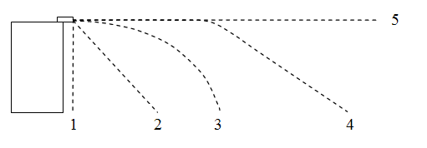
2.6.2. Two identical ping-pong balls are selected for a physics demonstration. A tiny hole is drilled in one of the balls; and the ball is filled with water. The hole is sealed so that no water can escape. Each ball is shot horizontally from a gun with an initial velocity v₀ from the top of a building. The following drawing shows several trajectories numbered 1 through 5. Which of the following statements is true?
a) Both balls would follow
trajectory 5.
b) Both balls would follow
trajectory 3.
c) The lighter ball would follow 4 and the heavier ball would follow 2.
d) The lighter ball would follow 4 and the heavier ball would follow 3.
e) The lighter ball would follow 4 or 3 and the heavier ball would follow 2 or 1, depending on the magnitude of v₀.

Slide 31
2.6.2. Two identical ping-pong balls are selected for a physics demonstration. A tiny hole is drilled in one of the balls; and the ball is filled with water. The hole is sealed so that no water can escape. Each ball is shot horizontally from a gun with an initial velocity v₀ from the top of a building. The following drawing shows several trajectories numbered 1 through 5. Which of the following statements is true?
a) Both balls would follow
trajectory 5.
b) Both balls would follow
trajectory 3.
c) The lighter ball would follow 4 and the heavier ball would follow 2.
d) The lighter ball would follow 4 and the heavier ball would follow 3.
e) The lighter ball would follow 4 or 3 and the heavier ball would follow 2 or 1, depending on the magnitude of v₀.

Slide 32
2.6.3. A cannon directed straight upward launches a ball with an initial speed v. The ball reaches a maximum height h in a time t. Then, the same cannon is used to launch a second ball straight upward at a speed 2v. In terms of h and t, what is the maximum height the second ball reaches and how long does it take to reach that height?
a) 2h, t
b) 4h, 2t
c) 2h, 4t
d) 2h, 2t
e) h, t

Slide 33
2.6.3. A cannon directed straight upward launches a ball with an initial speed v. The ball reaches a maximum height h in a time t. Then, the same cannon is used to launch a second ball straight upward at a speed 2v. In terms of h and t, what is the maximum height the second ball reaches and how long does it take to reach that height?
a) 2h, t
b) 4h, 2t
c) 2h, 4t
d) 2h, 2t
e) h, t

Slide 34
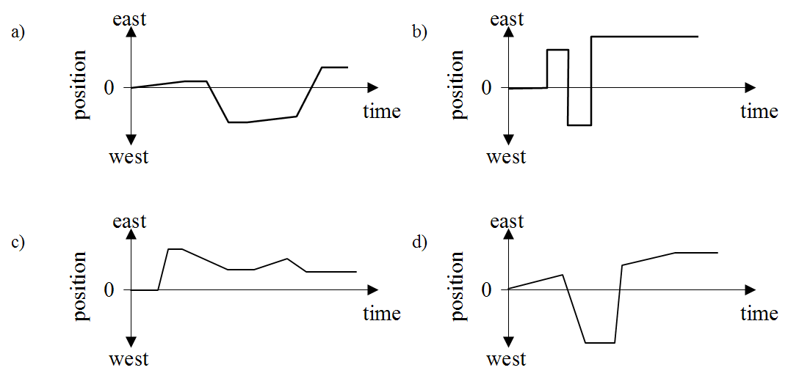
2.7.1. A dog is initially walking due east. He stops, noticing a cat behind him. He runs due west and stops when the cat disappears into some bushes. He starts walking due east again. Then, a motorcycle passes him and he runs due east after it. The dog gets tired and stops running. Which of the following graphs correctly represent the position versus time of the dog?

Slide 35
2.7.1. A dog is initially walking due east. He stops, noticing a cat behind him. He runs due west and stops when the cat disappears into some bushes. He starts walking due east again. Then, a motorcycle passes him and he runs due east after it. The dog gets tired and stops running. Which of the following graphs correctly represent the position versus time of the dog?

Slide 36
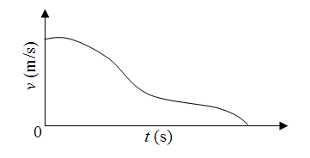
2.7.2. The graph below represents the speed of a car traveling due east for a portion of its travel along a horizontal road. Which of the following statements concerning this graph is true?
a) The car initially increases its speed, but then the
speed decreases at a constant rate until the car stops.
b) The speed of the car is initially constant, but then
it has a variable positive acceleration before it stops.
c) The car initially has a positive acceleration, but then it has a variable negative acceleration before it stops.
d) The car initially has a positive acceleration, but then it has a variable positive acceleration before it stops.
e) No information about the acceleration of the car can be determined from this graph.

Slide 37
2.7.2. The graph below represents the speed of a car traveling due east for a portion of its travel along a horizontal road. Which of the following statements concerning this graph is true?
a) The car initially increases its speed, but then the
speed decreases at a constant rate until the car stops.
b) The speed of the car is initially constant, but then
it has a variable positive acceleration before it stops.
c) The car initially has a positive acceleration, but then it has a variable negative acceleration before it stops.
d) The car initially has a positive acceleration, but then it has a variable positive acceleration before it stops.
e) No information about the acceleration of the car can be determined from this graph.

